Slide 1
WELCOME

Slide 2
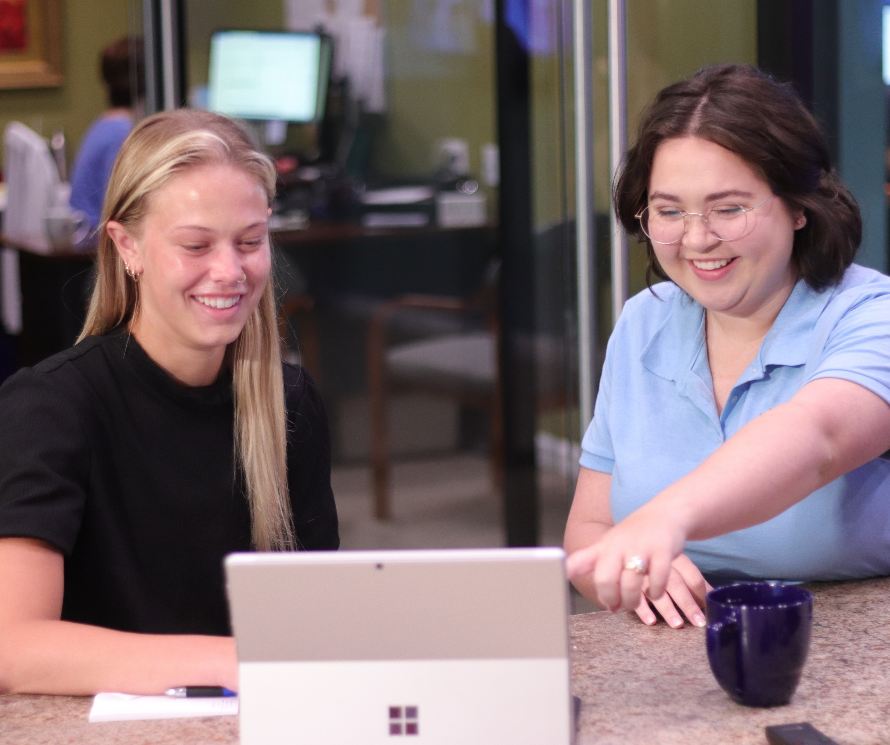

Slide 3
THANK YOU
RAFFLE / SILENT AUCTION DONORS
The Fabulous Fox Theatre Drury Hotels
The Clayton Plaza
Nancy Bukovic
Vicki Dolan
Total Wine
St. Louis Cardinals
Saint Louis Zoo
Missouri Historical Society
Missouri Botanical Garden
Deb Zimmerman
Diamonds Direct
Cynthia Goudy
Deb Zimmerman

Slide 4
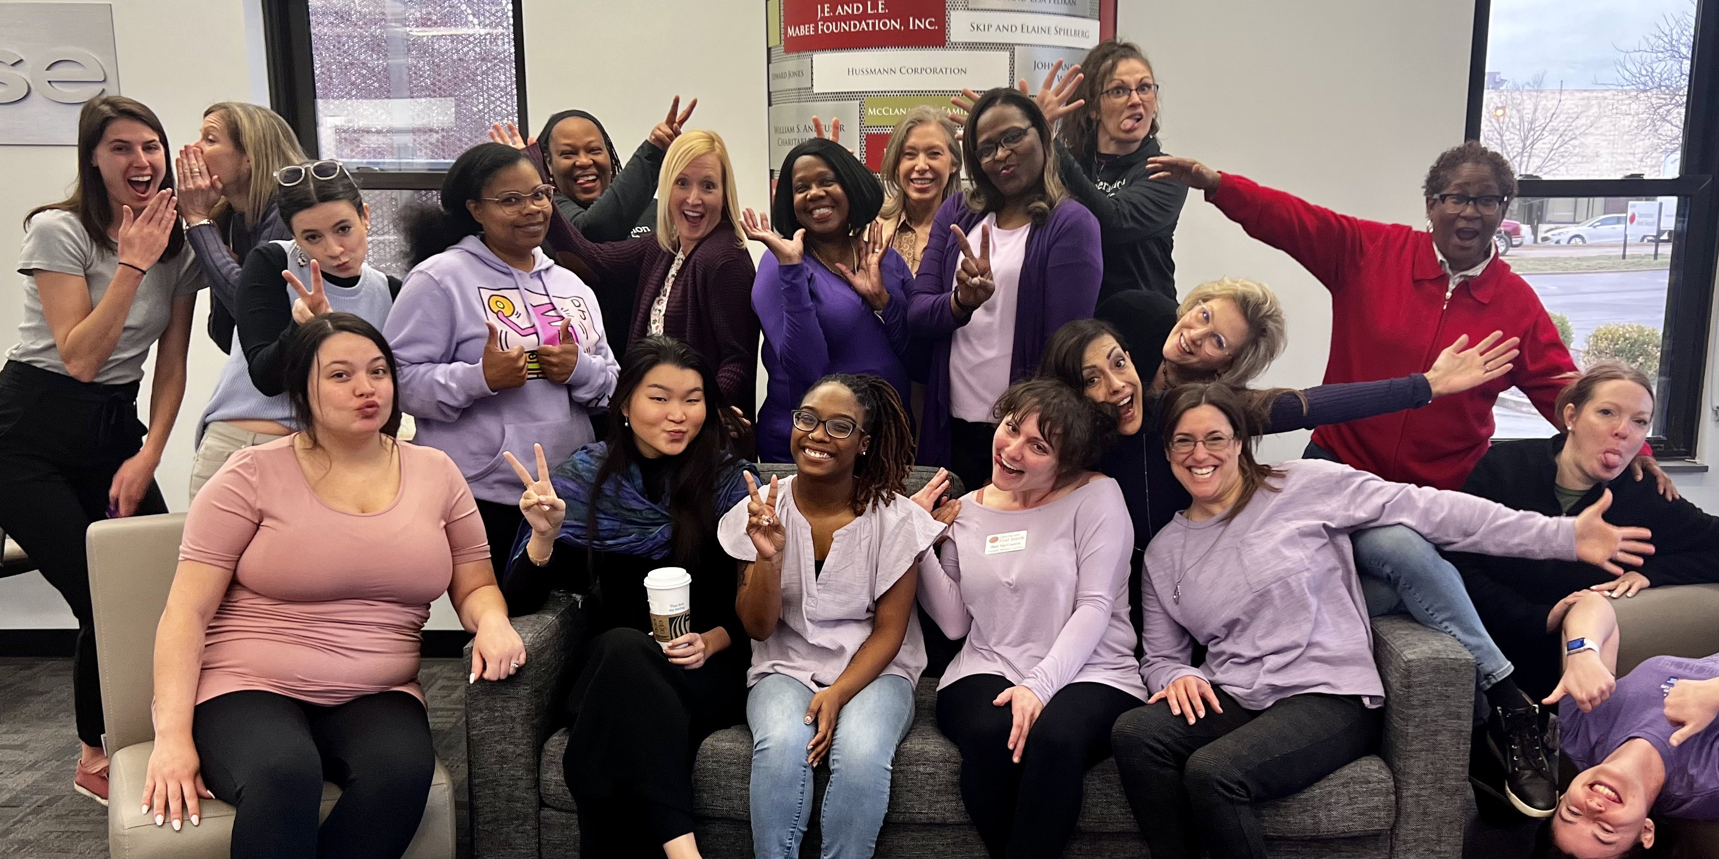

Slide 5
THANK YOU
LEADING THE CHARGE SPONSOR
A.

Slide 6
THANK YOU
B.
CHAMPION FOR WORKING WOMEN
SPONSORS

Slide 7
THANK YOU
CHANGE MAKER SPONSORS

Slide 8
THANK YOU
ADVOCATE SPONSORS
Anders CPAs + Advisors
Laborers International Union
Lewis Rice
Nine PBS
Stifel
Thompson Coburn
Anders CPAs + Advisors
McCarthy Building Company
HOK

Slide 9
THANK YOU
FRIEND SPONSORS
Commerce Bank
Laura Cohen
Lathrop GPM
Enterprise Bank & Trust
The Simon Law Firm
SUPPORTER SPONSORS
Sandra Murdoch

Slide 10
THANK YOU
TABLE HOSTS
Alberici
Robbye Frank
Sandra Murdock
Enterprise Mobility Legal Group
Rung
Nancy Bukovic
Kerry Donnelly

Slide 11
THANK YOU
TABLE HOSTS
Sandberg Phoenix
Dawn Humphreys
Enterprise Mobility RLD Sales & Collision Engineering
Davis & Travaglini, LLC
BenefitBump
Jessica Liss
Armstrong Teasdale

Slide 12
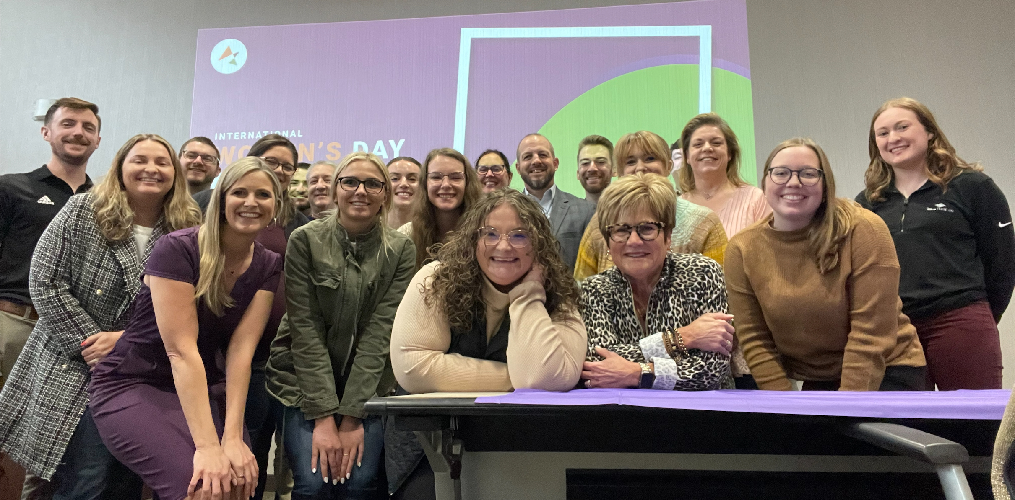

Slide 13
WOMEN IN THE WORKPLACE
EMPLOYMENT SCORECARD HONOREES

Slide 14
SMALL ORGANIZATIONS
(LESS THAN 50 EMPLOYEES)

Slide 15
MEDIUM ORGANIZATIONS
(50-499 EMPLOYEES)

Slide 16
LARGE ORGANIZATIONS
(500 OR MORE EMPLOYEES)

Slide 17
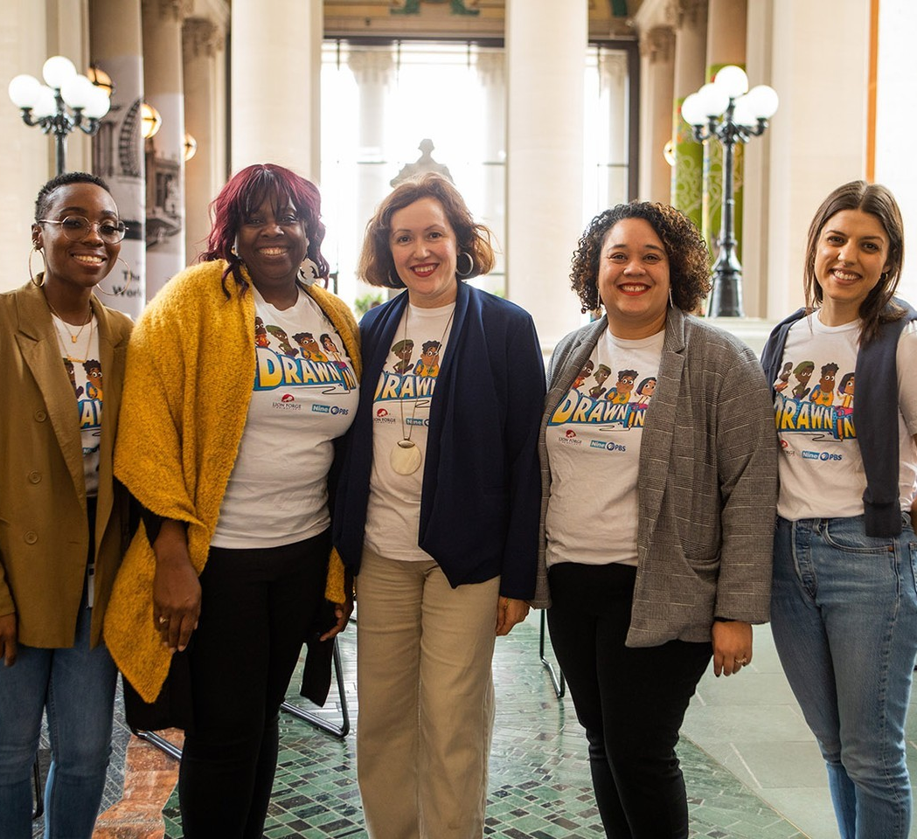

Slide 18
THE 2024 SURVEY WILL OPEN MARCH 2025

Slide 19
WFSTL 2024 GRANTEES
The Migrant and Immigrant Community Action Project
IHELP
Missouri Women in Trades
National Council of Jewish Women Saint Louis

Slide 20
EMPOWER YOUR EXECUTIVE PRESENCE
Strategies for Emerging Leaders
When:
October 24, 2024
8:30 a.m. – 10:00 a.m.
Where:
Vue 17
1034 S. Brentwood Blvd.
17th Floor
Brentwood, MO 63117

Slide 21
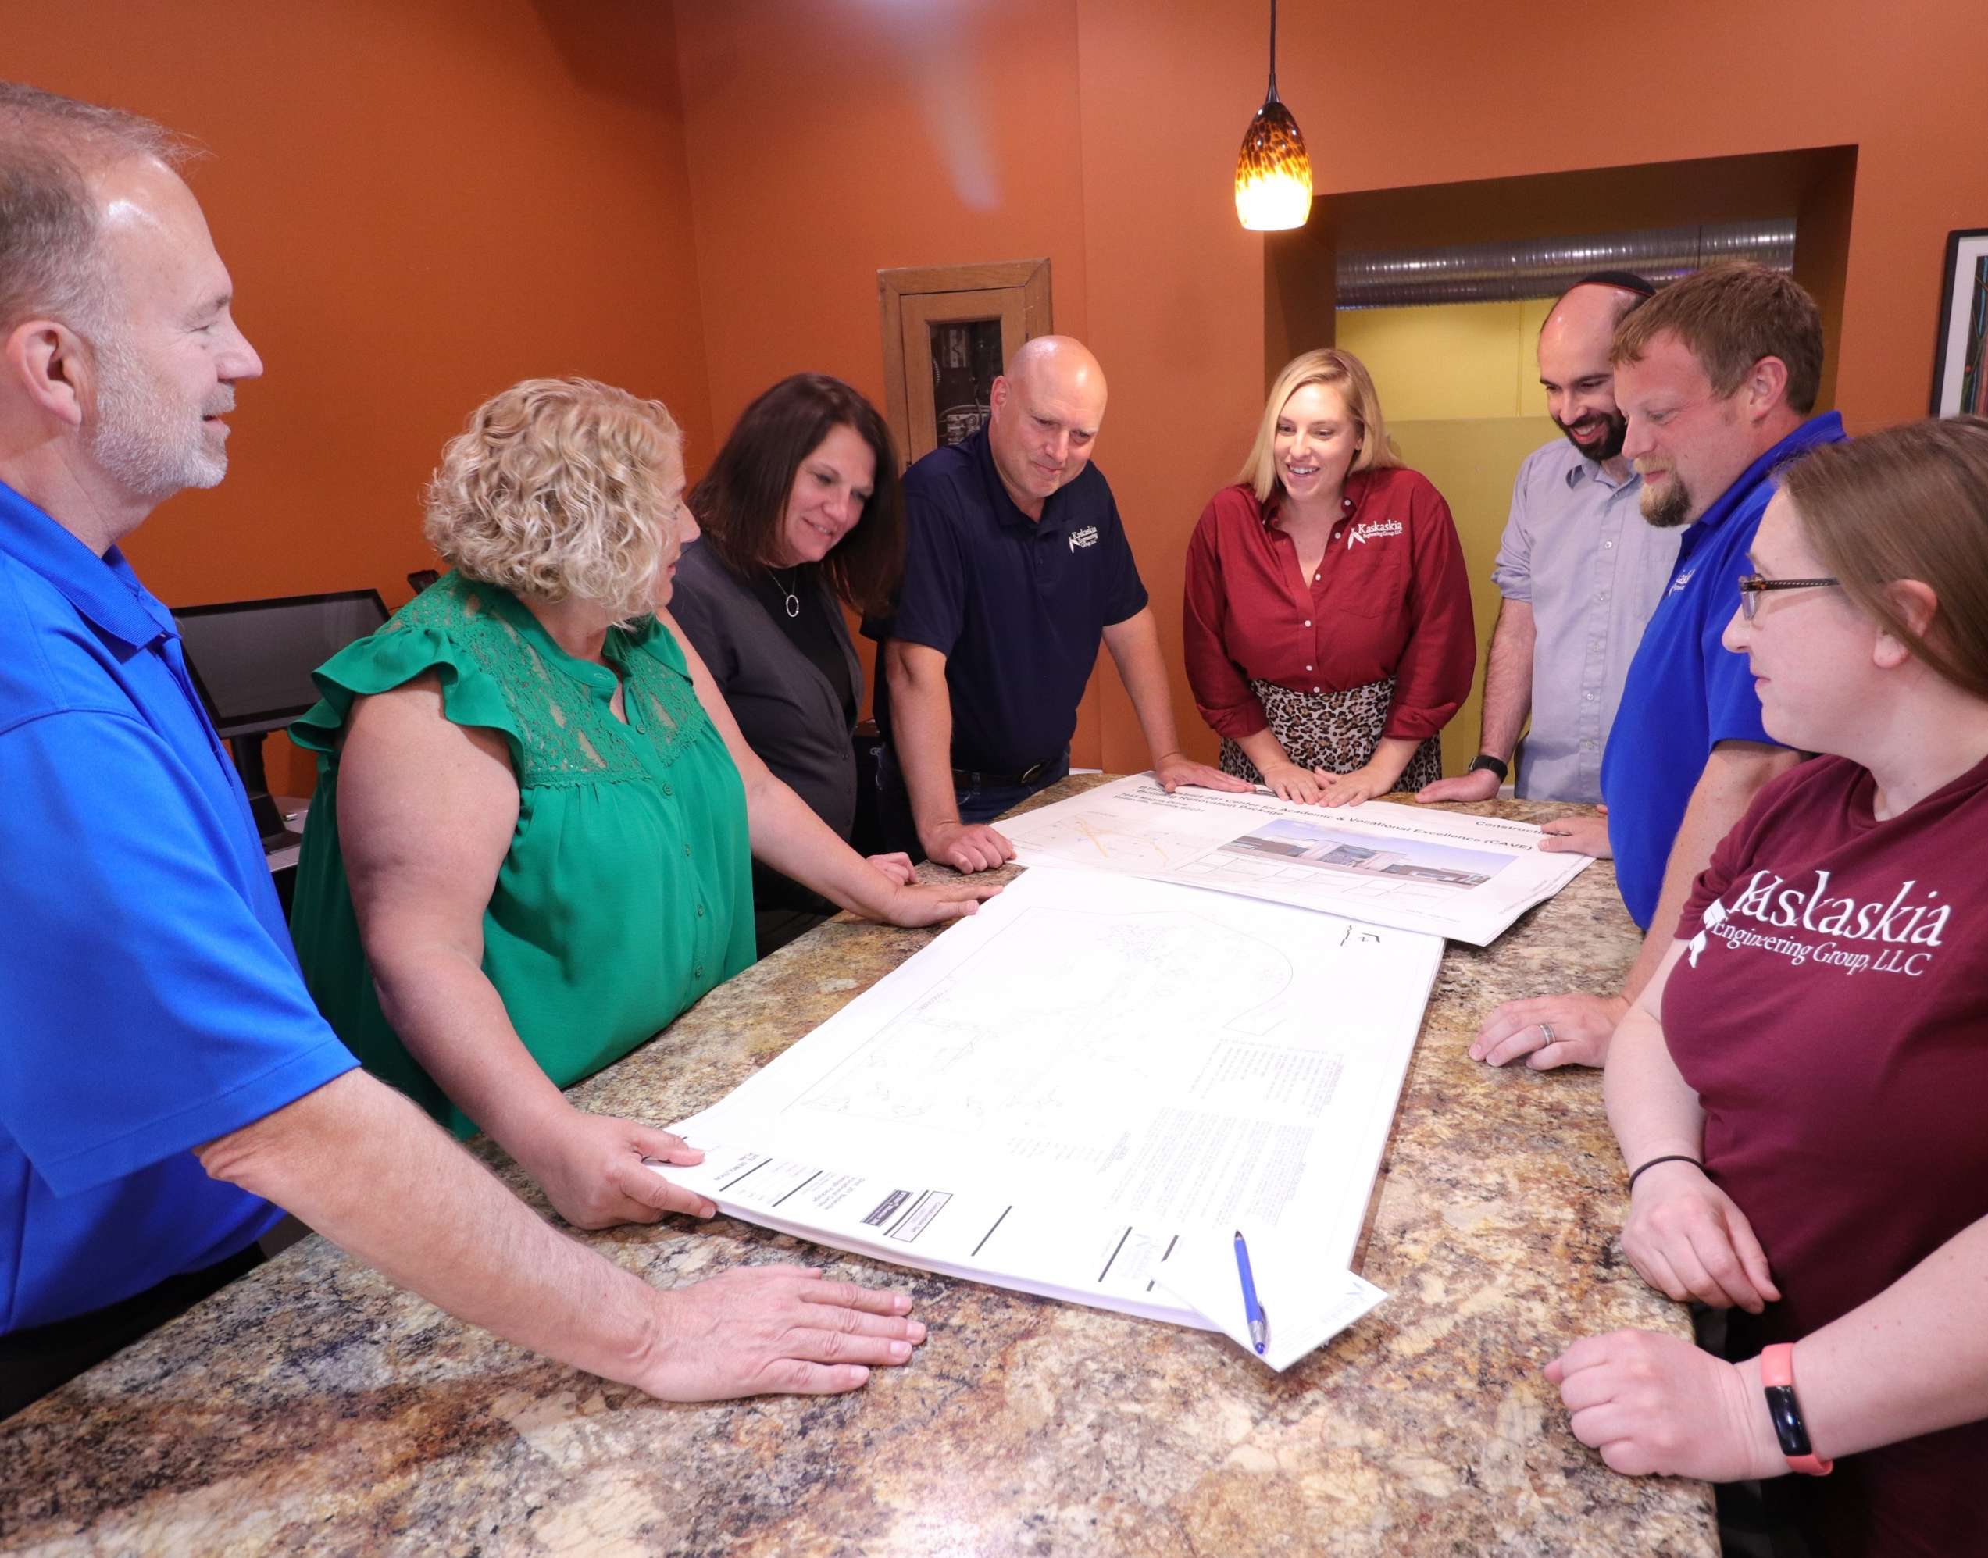

Slide 22
THANK YOU!

