Slide 1
Women in the Economy: An Underleveraged Powerhouse and Why it Matters to Businesses and Communities
Women’s Foundation of St. Louis
April 25, 2024
Ana H. Kent, Ph.D.
Senior Researcher
Institute for Economic Equity
*These are my own views and not necessarily those of the Federal Reserve Bank of St. Louis, the Federal Reserve System, or the Board of Governors.

Slide 2
Overview of Topics
Women in the workforce over time
Women in the U.S. versus other countries
Income and wealth gender gaps
Benefits of inclusion
Missouri-specific gains from equity

Slide 3
Women in the Workforce

Slide 4
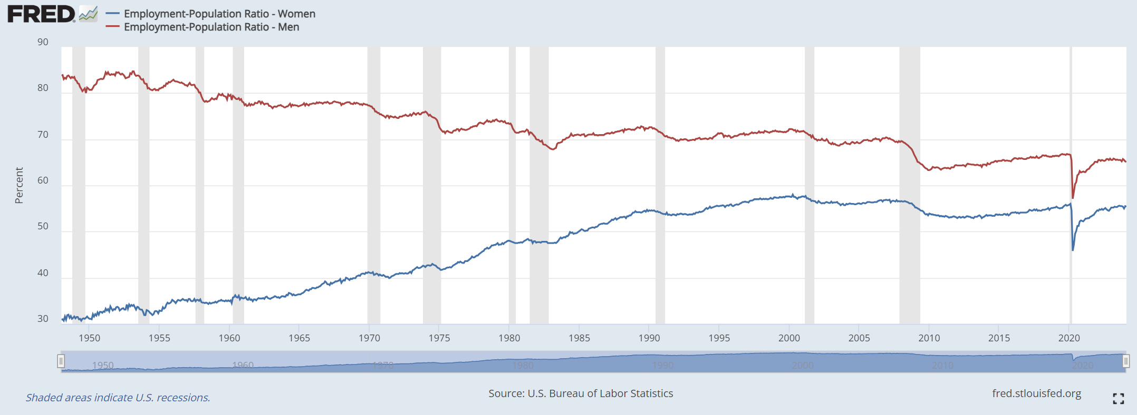
Women’s Employment Trends Upward While Men’s Trends Downward
65.1
55.4
Women make up about half of total nonfarm employment.

Slide 5
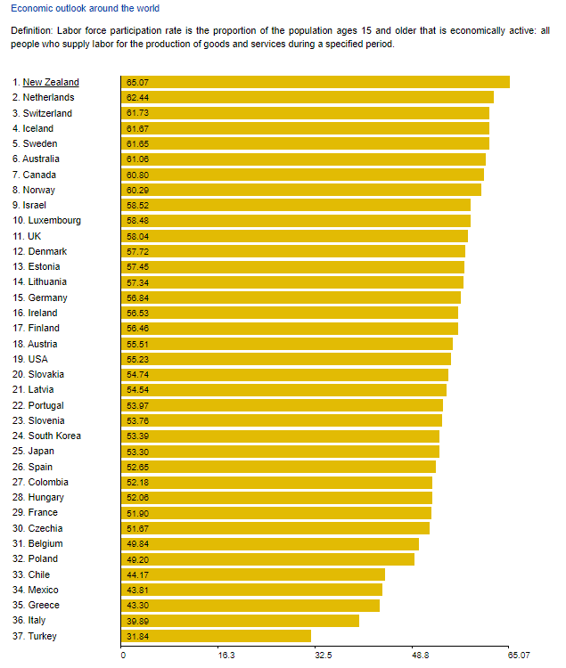
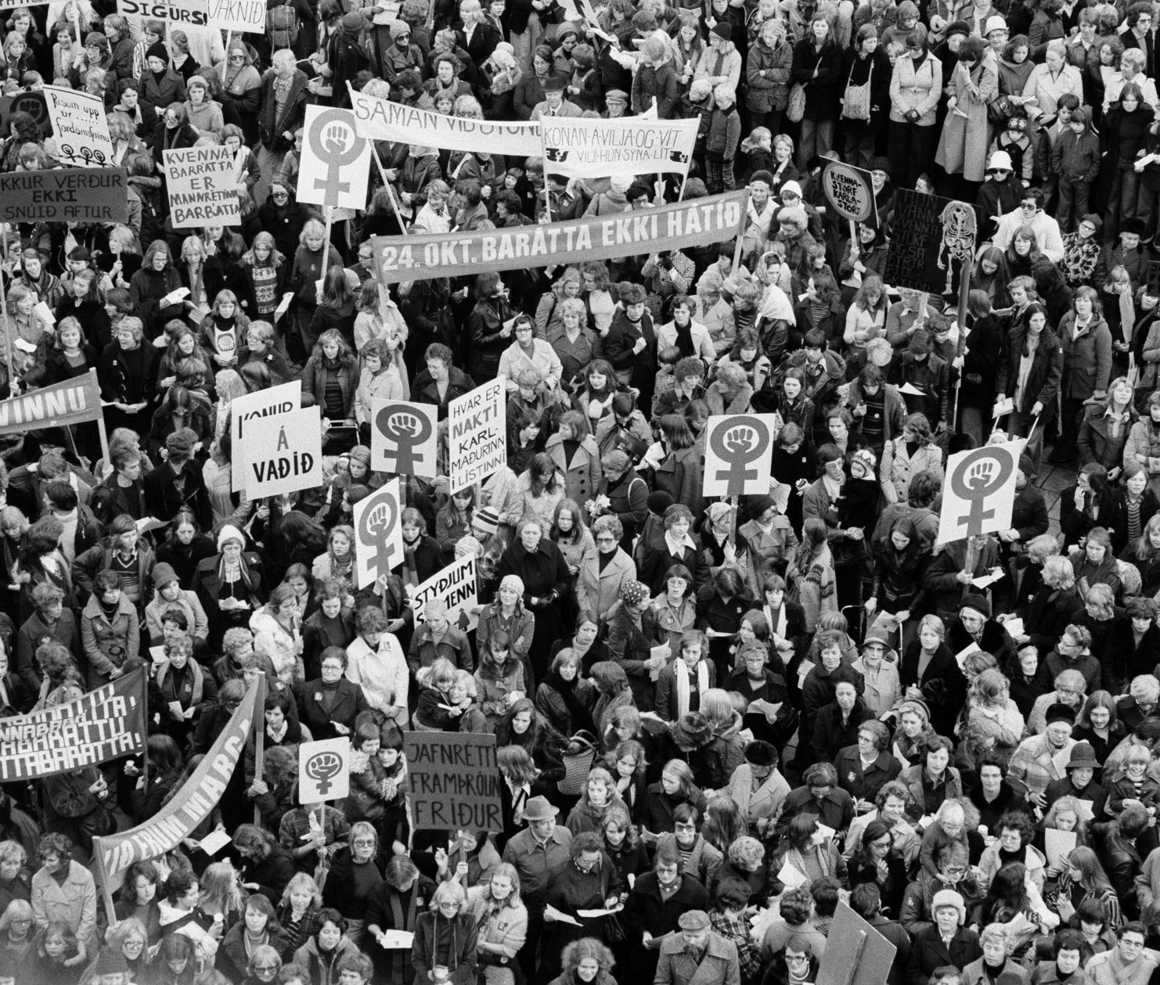
US: Middle of the Pack
OECD countries
Source: theglobaleconomy.com

Slide 6
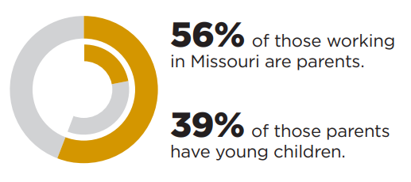
Childcare in Missouri
Labor Force Participation, 2021
Childcare is a key support for the workforce
Non-parent Parent
Non-parent Parent
Source: https://www.stlouisfed.org/community-development/child-care-economic-impact

Slide 7
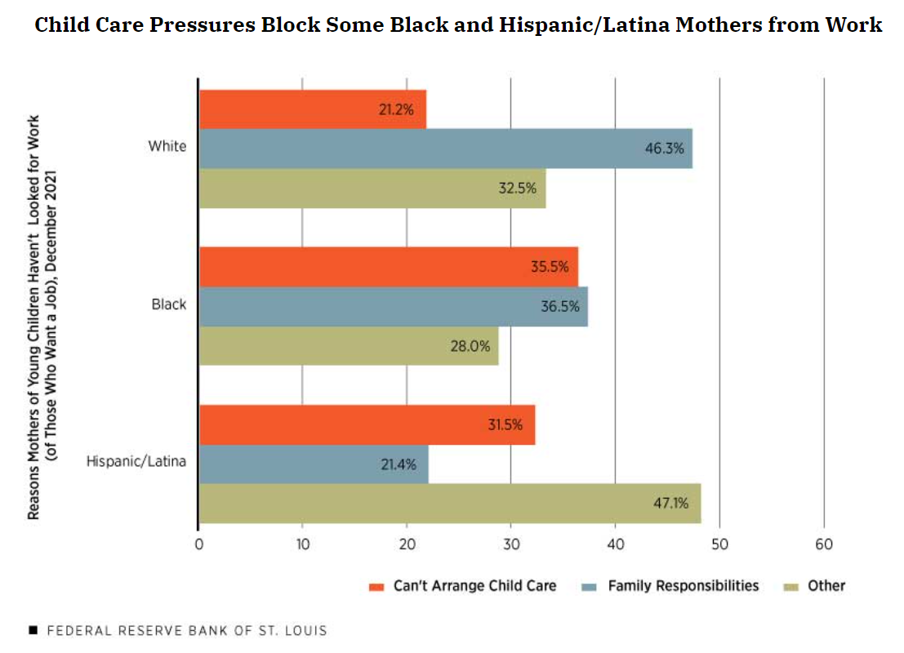
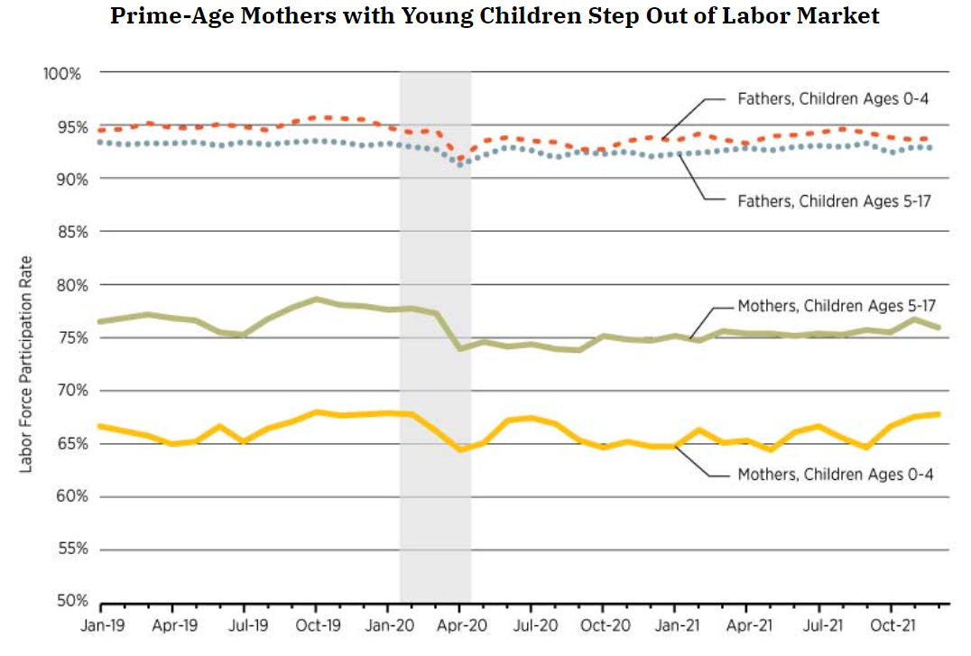
For Mothers of Young Children, Lack of Care Blocks Work
Source: https://www.stlouisfed.org/on-the-economy/2022/feb/child-care-remains-central-equitable-recovery

Slide 8
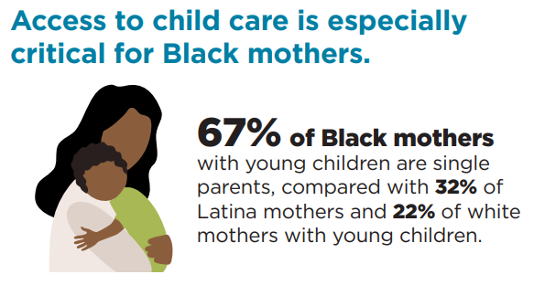
Childcare in Missouri
Childcare is a key support for the workforce, yet…
Unavailable: Over half of Missourians live in a childcare desert
Unaffordable: Average cost is $8,100/year per child; 13% of median household income
Single moms: 97% nationwide would find average cost of care unaffordable
Source: https://www.stlouisfed.org/community-development/child-care-economic-impact

Slide 9
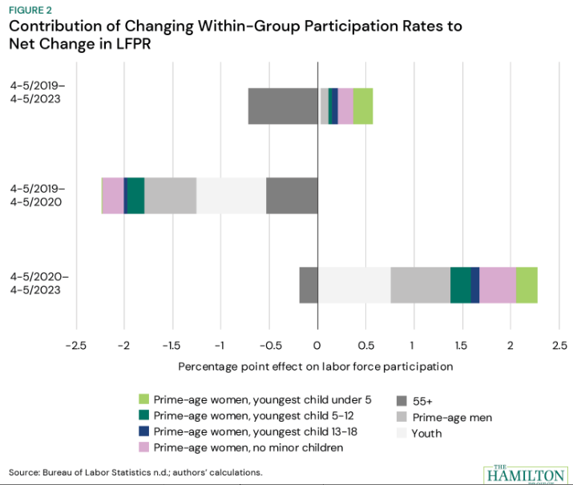
Mothers with Young Children Powering Workforce
Women (and in particular, mothers of young children) are powering the rebound in the overall LFP rate
Highly educated
Married
In 2023, Missouri made its largest investment in early childhood education—$160 million, including $78 million to boost child care subsidies and another $82 million for state-funded prekindergarten programs.
Source: Brookings, Bauer & Wang (Aug. 2023)

Slide 10
Current Economic Gaps

Slide 11
Economic Gaps
Wage Gap
$0.82/$1
Mothers earn $0.75/$1 earned by fathers
Women in STL metro earned 78 cents per $1
Financially Insecure
39% of women wouldn’t have been able to handle a $400 emergency expense with cash or its equivalent in 2022
Low-Wage, Low-Benefit
Women are overrepresented in low-wage jobs with less access to wealth-building workplace benefits
Limited Free Time
Working mothers spend more time doing household- and childcare-related activities than fathers
Sources: Pew, (National Women’s Law Center)

Slide 12
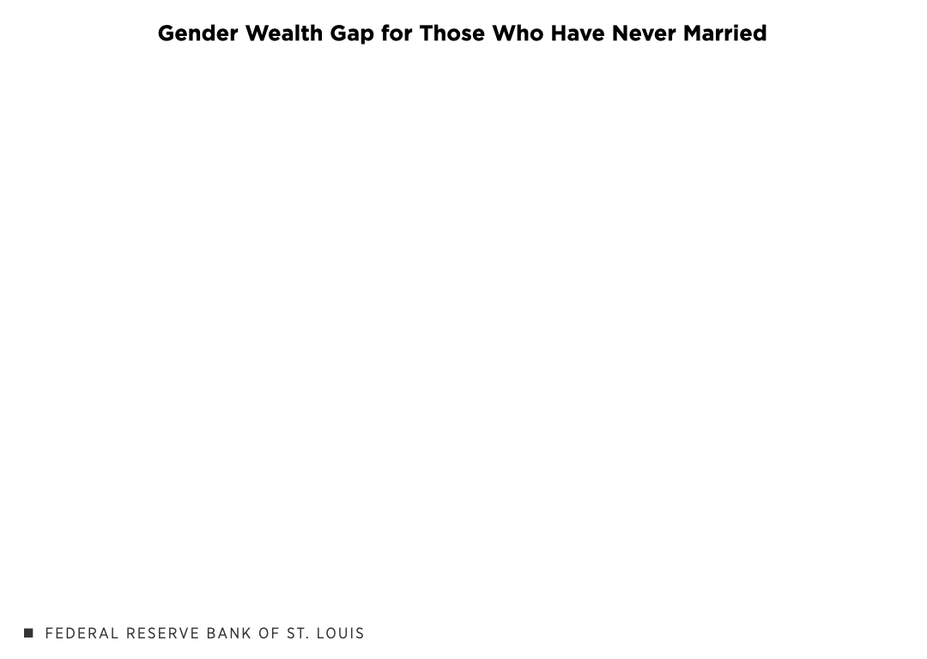
Gender Wealth Gap
In 2022, for all marital statuses:
55¢ per $1
Source: Kent, forthcoming

Slide 13
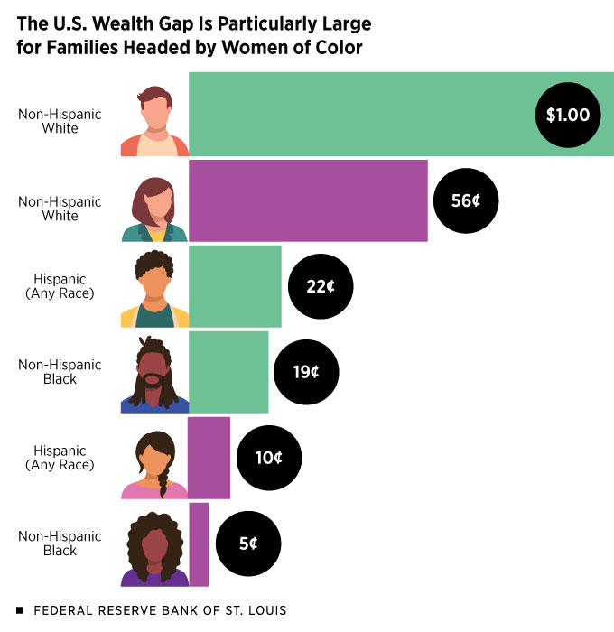
Gender Gap Larger for Women of Color and Single Mothers
Source: Kent, 2024; Kent, 2021. “Gender Wealth Gaps in the U.S. and Benefits of Closing Them”

Slide 14
Gender Gap Larger for Women of Color and Single Mothers
Source: Kent, 2024; Kent, 2021. “Gender Wealth Gaps in the U.S. and Benefits of Closing Them”

Slide 15
Who Qualifies for Social Security?
Can you qualify based off a spouse’s earnings record?
Source: Kent, 2024 “Do You Qualify for Social Security Benefits through Your Spouse or Ex?”

Slide 16
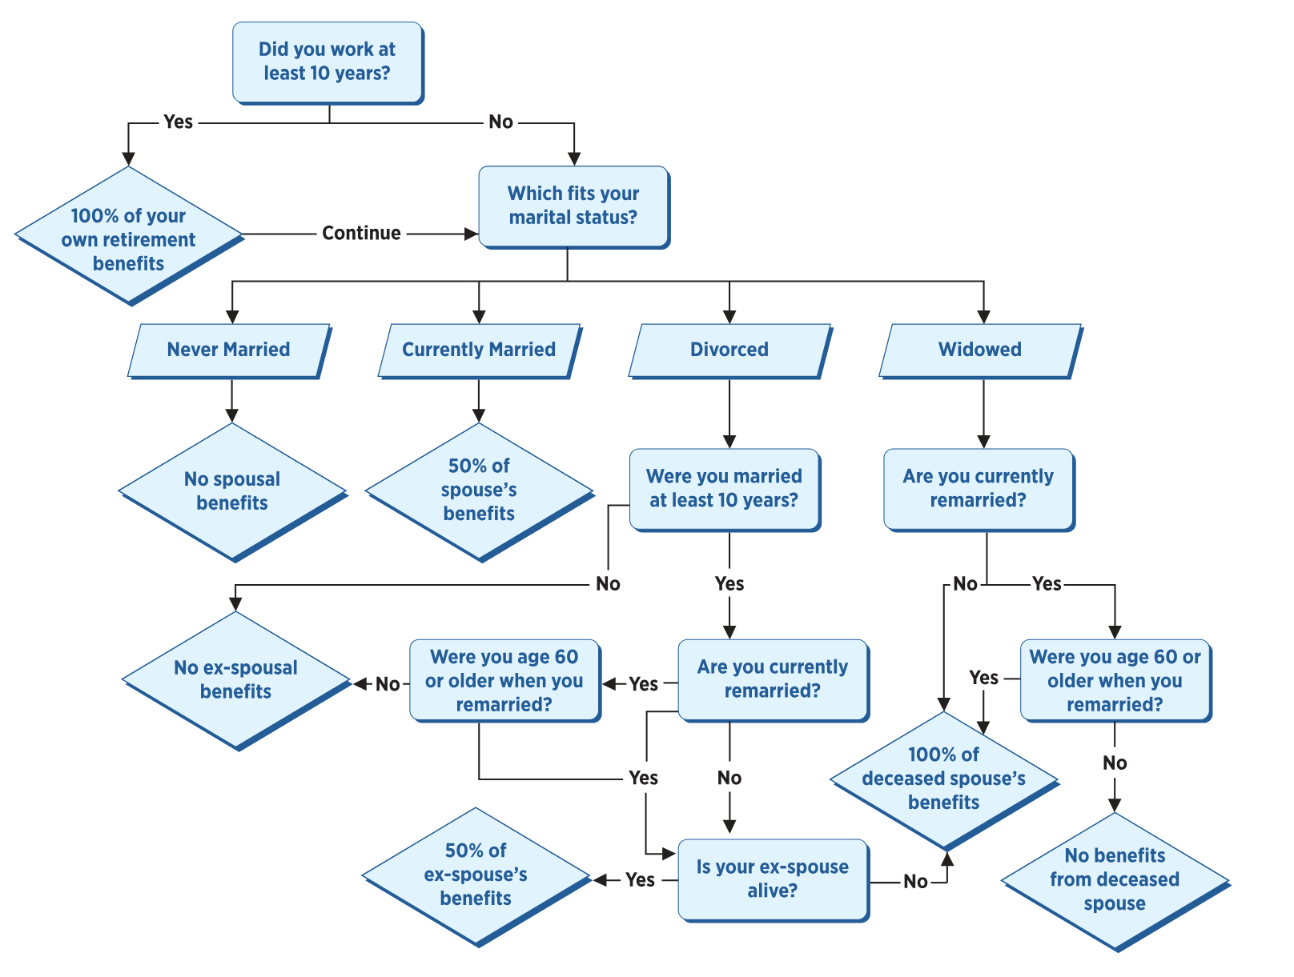
Who Qualifies for Social Security? (Ex) Spouses Can
Social Security includes three types of benefits: retirement, survivor (i.e., the worker has died) and disability.
Spouses in each of these categories are eligible as well.
93% of spousal retirement benefits go to women.
Benefits can be “topped-off” but not added together.
Source: Kent, 2024 “Do You Qualify for Social Security Benefits through Your Spouse or Ex?”

Slide 17
Who Qualifies for Social Security? (Ex) Spouses Can
Social Security includes three types of benefits: retirement, survivor (i.e., the worker has died) and disability.
Spouses in each of these categories are eligible as well.
93% of spousal retirement benefits go to women.
Benefits can be “topped-off” but not added together.
Source: Kent, 2024 “Do You Qualify for Social Security Benefits through Your Spouse or Ex?”

Slide 18
Benefits of Inclusion

Slide 19
Why including women fully benefits us all
Thriving families
International competitiveness
Economic growth and vibrant businesses
“There’ve been very well paying jobs where I just had to say no because I didn't have sufficient care.” – Urban Black parent, one child under 5, Federal Reserve study
Kent, 2022. “Why supporting working moms benefits families, employers, and you”

Slide 20
Why including women fully benefits us all
Thriving families
Families rely on women’s (and mothers’) wages more than ever before
Upward mobility for next generation
Investing in children early: Early child development programs have long-term economic and societal benefits
Kent, 2022. “Why supporting working moms benefits families, employers, and you”

Slide 21
Why including women fully benefits us all
International competitiveness
U.S. women’s participation in labor force lags other comparable countries
Also the only industrialized country with no paid family/medical leave
Few family-friendly policies
Kent, 2022. “Why supporting working moms benefits families, employers, and you”

Slide 22
Why including women fully benefits us all
Economic growth and vibrant businesses
Most women will become mothers
Tax revenue increase, GDP growth, less reliance on social safety net
Larger pool of senior women to pick for leadership roles
Diversity of ideas, innovation
Increased productivity and employee morale, reduced turnover and absenteeism
Kent, 2022. “Why supporting working moms benefits families, employers, and you”

Slide 23
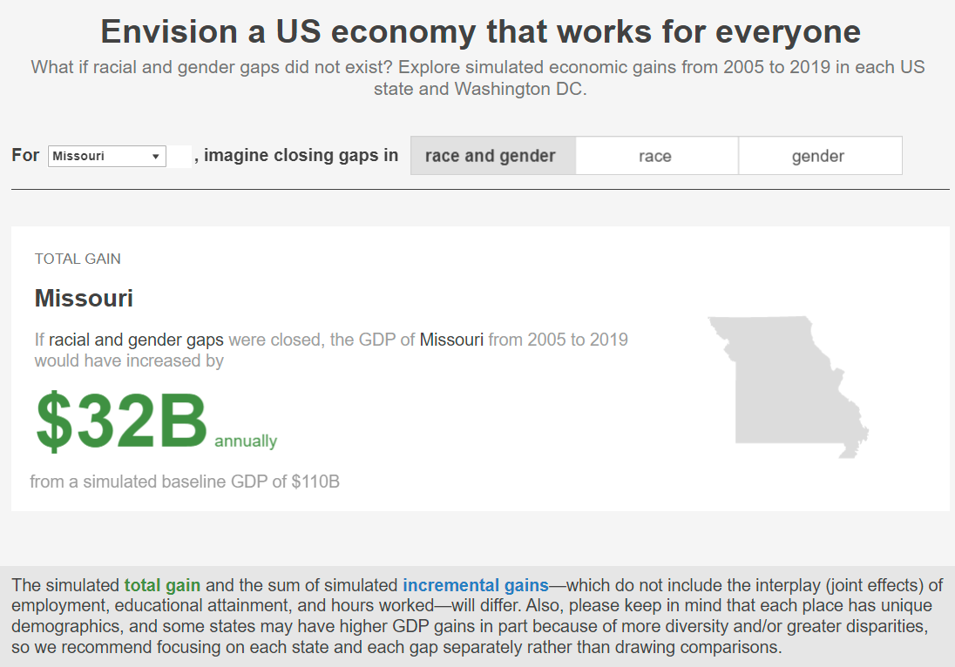
Earnings
Employment
Hours worked
Educational attainment
Gains from Equity

Slide 24
Gains from Equity
https://fedcommunities.org/data/closethegaps/
Earnings
Employment
Hours worked
Educational attainment

Slide 25
Conclusion: Supporting Women Benefits Us All
Economic imperative:
Women’s importance to families’ financial stability and mobility
Broad benefits: per-worker GDP is relatively constant and economy is a function of labor force
Increase in tax revenue, decrease in reliance on public benefits

Slide 26
Conclusion: Supporting Women Benefits Us All
What can be done?
Individual Level: Have the uncomfortable conversations; take advantage of your own economic power; offer mentorship; model work-life balance in your own life
Employer Strategies: offering childcare at work or backup care; payroll deduction toward care for tax-advantage; flexible schedules; paid FML; telework options
Public Investment: increase childcare subsidies; public pre-kindergarten programs; address benefits cliffs

Slide 27
X.
X. ana_h_kent

Slide 29
References
American Community Survey
Census
Federal Reserve Board’s Survey of Consumer Finances. Link.
https://childcaredeserts.org/2018/?state=MO
https://fedcommunities.org/benefits-supporting-working-moms/
https://fedcommunities.org/data/closethegaps/
https://fred.stlouisfed.org/
https://www.federalreserve.gov/publications/2021-november-consumer-community-context.htm
https://www.stlouisfed.org/community-development/child-care-economic-impact
https://www.stlouisfed.org/on-the-economy/2022/may/single-mothers-slim-financial-cushions
https://www.stlouisfed.org/open-vault/2021/september/gender-wealth-gaps-us-benefits-of-closing-them
https://www.stlouisfed.org/open-vault/2022/jul/benefits-of-supporting-working-moms
https://www.theglobaleconomy.com/rankings/female_labor_force_participation/OECD/
R Core Team (2020). R: A language and environment for statistical computing. R Foundation for Statistical Computing, Vienna, Austria. Link.

